Slide 1
Visualizing Employees Attendance Trends With Excel Chart
STUDENT NAME: POOJA S
REGISTER NO: 312217022 (F5F75E955E73B12ABDA47C11EA621037)
DEPARTMENT: B.COM (GENERAL)
COLLEGE: SHRI KRISHNASAMY COLLEGE FOR WOMEN

Slide 2
PROJECT TITLE
Visualizing Employees Attendance Trends With Excel Chart

Slide 3


AGENDA
Problem Statement
Project Overview
End Users
Our Solution and Proposition
Dataset Description
Modelling Approach
Results and Discussion
Conclusion
3/21/2024 Annual Review

Slide 4

PROBLEM STATEMENT
Inefficient resource allocation: Without accurate attendance data, managers are unable to optimize staffing levels, leading to over or under-staffing.
Poor workforce planning: Attendance trends are not being used to inform scheduling, recruitment, and training decisions.
Increased absenteeism: Without identifying patterns and trends, absenteeism is not being addressed, leading to decreased productivity.
Decreased productivity: Excessive absenteeism and tardiness are impacting team performance and overall productivity.

Slide 5

PROJECT OVERVIEW
Creating an interactive Excel dashboard to visualize employee attendance trends.
Automate attendance tracking, provide real-time insights, reduce absenteeism,
and improve productivity
Importing attendance data, designing and developing the dashboard, and
implementing filters and slicers.
Interactive Excel dashboard, user guide, and regular data updates.
Improved attendance tracking, enhanced workforce planning, reduced
absenteeism, and increased productivity
.

Slide 6

WHO ARE THE END USERS?
HR manager
Department head
Team lead
Business owner
Operations manager
Payroll administrator
Employee engagement

Slide 7

OUR SOLUTION AND ITS VALUE PROPOSITION
Automated attendance data tracking
Interactive charts and visualizations (line, bar,
heat map)
Real-time data updates
Filters and slicers for drill-down analysis (by
department, team, employee)
User-friendly dashboard design
Improve attendance tracking
Enhance decision-making
Increase efficiency

Slide 8
Dataset Description
Employee ID: Unique identifier for each employee
Name: Employee name
Department: Department or team the employee belongs to
Date: Date of attendance
Attendance Status: Present, Absent, Late, or Left Early
Reason for Absence

Slide 9

THE "WOW" IN OUR SOLUTION
Real-time attendance trend analysis
Interactive and dynamic
Automated data updates
Customizable and scalable
Data-driven storytelling
Proactive absenteeism
Enhanced employee engagement
Unparalleled visibility
3/21/2024 Annual Review
9

Slide 10
MODELLING
Data Collection:
Collect attendance data from HR systems or payroll software- Import data into Excel- Organize data by employee, date, and attendance status (present, absent, late, etc.).
Data Processing:
Use Excel formulas to calculate attendance metrics (e.g., attendance rate, absenteeism rate)- Create pivot tables to summarize data by department, team, and date range- Use conditional formatting to highlight trends and anomalies.
Data Visualization:
Create interactive charts (e.g., line, bar, heatmap) to display attendance trends- Use filters and slicers to enable drill-down analysis by department, team, and date range- Add charts to a dashboard for easy visualization.
10

Slide 11
MODELLING
Dashboard Creation:
Design a user-friendly dashboard with charts, filters, and slicers- Use Excel's built-in dashboard tools (e.g., Dashboard Designer) or third-party add-ins (e.g., Power BI)- Ensure dashboard is interactive and easy to navigate.
Analysis and Insights:
Analyze attendance trends to identify patterns and anomalies- Use data-driven insights to inform HR and management decisions- Monitor and adjust attendance strategies based on dashboard insights.
Maintenance and Updates:
Schedule regular data updates to ensure dashboard accuracy- Monitor dashboard performance and make adjustments as needed- Provide training and support for end-users to ensure effective use of the dashboard.

Slide 12
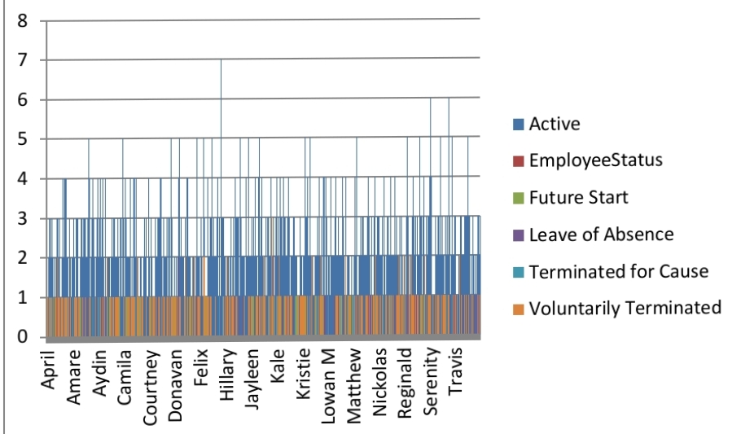
RESULTS
12

Slide 13
conclusion
Visualizing employee attendance trends with Excel
charts is a valuable tool for HR and management to gain
insights into attendance patterns, absenteeism, and
productivity.
The "Attendance Insights" dashboard provides a
user-friendly and interactive way to explore and analyze
attendance data, enabling organizations to drive
business success and enhance employee experience.
Regular review and analysis of attendance trends can
help organizations identify areas for improvement,
reduce absenteeism, and improve overall organizational
performance.

